Slide 1


Zero-Carbon Travel Patterns Decision-making System
University of Washington, CSE 583 Software Development for Data Scientists, Fall 2021
Chin-Wei Chen, Zining Cheng, Iman Haji, Haoyu Yue
Nov 16, 2021
Notes:
Title + team members
Air travel is the main carbon source at the personal level

Slide 2
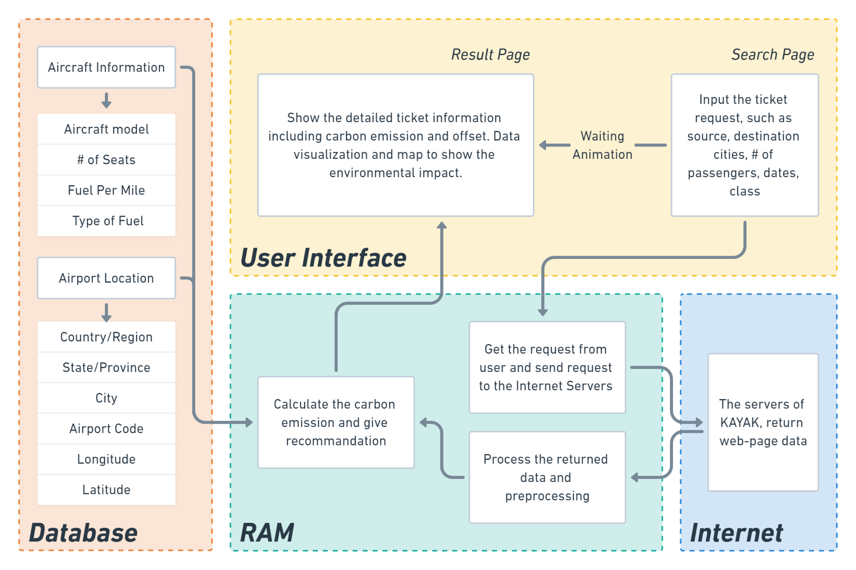
Background
Today We FOCUS on
How to Get Flight Ticket Data
Users Input the Requests
Access to the databases
Extract Flight Info
Notes:
Left: the main structure and flow chart (skip)
Interactive system (website) -> users can search flight tickets and get the basic results and the estimated carbon emission -> we recommend users to use various approaches to make their travels neutral
Today, we mainly focus on one main step, which is the stops within the red dash line. after receiving requests from users, how to get the flight ticket information, even real-time data?

Slide 3
What technologies you considered
Static Databases
Hard to find with prices, meaningless, huge dataset
Existing API
Not up-to-date, do not fit our demands, limited functions for free
Self-made Robots
Decision √
Practice chance, fit our project perfectly
Notes:
there are three potential technologies to extract our flight ticket data.
Static database is the most direct idea, but there is no existing database including flight ticket prices.
API is a software intermediary that allows two applications to talk to each other
We do some tech review on Existing API, we found there are several open-source API, but most of them have lots of limitations when we using in our project. Additionally, most of these data is not up-to-date, and not free of charge.
Therefore, we would choose to do a self-made robot, which could crawl the real time data from existing flight booking website.
It is more flexible, and we could get the ticket prices we need.

Slide 4

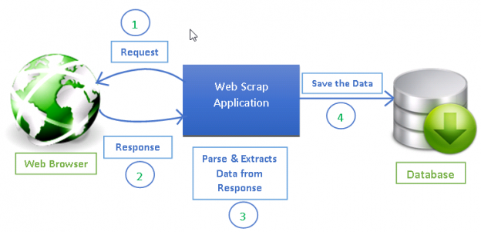
Crawling in python: what you chose to use
Request: the requests module allows you to send HTTP requests using Python
Beautifulsoup: a Python library that is used for web scraping purposes to pull the data out of HTML files
 | Scrapy | BeautifulSoup
Functionality | Complete package | Basically an HTML parser Requires additional libraries to open URLs and store the result
Learning Curve | A powerhouse for web scraping, but requires more time to learn | Relatively easy to understand for newbies
Speed and Load | Scrapy can get big jobs done very easily | Used for simple scraping jobs with efficiency, although it is slower
Extending functionality | Allow to write functions in your spider that can process your data | If the project does not require much logic
USER
Beautiful-soup
Source: Datacamp. https://www.datacamp.com/community/tutorials/making-web-crawlers-scrapy-python
Notes:
there are two main packages that could do the crawling, Scrappy and Beautifulsoup
Scrapy is a complete package to crawl data in python and it could get big jobs done very easily.
However, we we will use another package, Beautifulsoup, to extract data.
Beautifulsoup: a Python library that is used for web scraping purposes to pull the data out of HTML files
It is more easy to understand for newbies, and to do some simple jobs with efficiency.
And we will use REQUEST with BEAUTIFULSOUP, which help us send requests to specific website.
Requests: the requests module allows you to send HTTP requests using Python. The HTTP request returns a Response Object with all the response data (content, encoding, status, etc).
Request: allows you to send HTTP/1.1 requests extremely easily. There’s no need to manually add query strings to your URLs, or to form-encode your POST data. Keep-alive and HTTP connection pooling are 100% automatic, thanks to urllib3.
Advantage:
Be ready for today’s web
Keep-Alive & Connection Pooling
International Domains and URLs
Automatic Content Decoding
Multipart File Uploads
Beautiful Soup is a Python library that is used for web scraping purposes to pull the data out of HTML and XML files. It creates a parse tree from page source code that can be used to extract data in a hierarchical and more readable manner.
Advantage:
Very fast
Extremely lenient
Parses pages the same way a Browser does
Prettify the Source Code
https://analyticsindiamag.com/beautiful-soup-webscraping-python/

Slide 5
Crawling- Appeal of choice
Achieve Automation
Business Intelligence & Insights
Unique and rich datasets
Create applications for tools that don’t have a public developer API
Effective Data Management
Notes:
Achieve Automation
Robust web scrapers allow you to automatically extract data from websites, this allows you or your co-workers to save time that would’ve have otherwise been spent on mundane data collection tasks. It also means that you can collect data at greater volume than a single human could ever hope to achieve.
Also it’s possible for you to create sophisticated web bots to automate online activities with either web scraping software or using a programming language such as javascript, python, go or php.
Business Intelligence & Insights
Web scraping data from the internet allows you to search for competitor prices, monitor their marketing activity and to swiftly market research your industry online. By downloading, cleaning and analysing data at significant volume, you’ll be able to build a better picture of your market, your competitor’s activity which in turn will lead to better business decision making.
Unique and rich datasets
The internet provides you with a rich amount of text, image, video and numerical data and currently contains at least 6.05 billion pages. Depending upon what your objective is, you can find relevant websites, setup website crawlers and then make your own custom dataset for analysis.
For example, let’s pretend you’re interested in UK football and want to understand the sports market in depth.
You could setup webscapers to gather the following information:
Video Content: To download all of the football games from YouTube or Facebook.com.
Football Statistics: You could download your desired team’s historical match statistics.
WhoScored – Goal Data.
SoccerStats.
Betting Odds: You could collect the betting odds for football matches from bookmaker’s such as Bet365 or from player betting exchanges such as Betfair or Smarkets.
Create applications for tools that don’t have a public developer API
By web scraping data, you will never need to rely on the website releasing a public application programming interface (API) to access the data which they show on their webpages. There are several benefits to web scraping in comparison to accessing a public API:
You can access and collect any data that is available on their website.
You are not limited to a specific number of queries.
You don’t have to sign up for an API key or need to abide by their rules.
Effective Data Management
Instead of copying and pasting data from the internet, you can choose what data you would like to collect from a range of websites, then you can accurately collect it with web scraping. For more advanced web scraping / crawling techniques your data will be stored within a cloud database, and will likely be running on a daily basis.
Storing data with automatic software and programs means that your company, operations or employees can spend less time copying and pasting information and more time on creative work.

Slide 6
Crawling- Drawbacks of choice
Need to learn programming, use web scraping software or to pay a developer
Websites regularly change their structure and crawlers require maintenance
Careful about IP detection and robot.txt
Notes:
You will need to learn programming, use web scraping software or to pay a developer
If you are looking to collect and organise a vast amount of information from the internet, you will find that existing web scraping software is limited in functionality. Although the software can be good for extracting several elements from a web page, as soon as you need to crawl multiple websites they are less effective.
Therefore you will need to either invest in learning web scraping techniques in a programming language such as javascript, python, ruby, go or php. Alternatively you can hire a freelance web scraping developer, regardless both of these two approaches will add an overhead to your data collection operations.
Websites regularly change their structure and crawlers require maintenance
As websites regularly change their HTML structure, sometimes your crawlers will break. Whether you’re using web scraping software or you’re writing the web scraping code, there is a certain amount of maintenance that needs to be regularly performed to keep your data collection pipelines clean and operational.
For every website that you write a custom encoding script, adds on a certain amount of technical debt. If lots of websites that you’re collecting data from suddenly decide to redesign their websites, you will need to invest in fixing your crawlers.
IP detection
If you want to conduct data mining/crawling for one website, it would be wise to invest in proxies. The reason for this is that if you want to crawl a large website, in order to send enough daily HTTP requests by using a proxy you’ll limit the chance that your IP will be banned.
Remember that when you’re web scraping someone’s website you will be using their server’s resources, so its always best practice to:
Be respectful and avoid plagiarising their content.
Set gentle rate limits on how many daily HTTP requests you will make to their website.
Use proxies to mitigate that your crawling efforts are discovered.

Slide 7
Reference
Requests: HTTP for Humans™. https://docs.python-requests.org/en/latest/
Scrape Beautifully With Beautiful Soup In Python. https://analyticsindiamag.com/beautiful-soup-webscraping-python/
The Advantages & Disadvantages of Web Scraping Data. https://understandingdata.com/the-advantages-disadvantages-of-web-scraping-data/
Web Crawlers in Python- A case in PCHOME website. [Mandarin]. .https://www.youtube.com/watch?v=YHc6KvLsv20
Making Web Crawlers Using Scrapy for Python. https://www.datacamp.com/community/tutorials/making-web-crawlers-scrapy-python

